Slide 1
Time Series Exploration of Average Daily AAPL Price
Analysis conducted by: Joe Leong, Ryan Isherwood, Sam Whittaker

Slide 2
Outline
Objective
Is data suitable for time series analysis
Use adequate models to predict prices over next 10 days
Methods
Transformation of data
ACF/PACF plots
Fit to Arima Models
Analysis
Checking to see if the model fit is adequate
Prediction
Conclusion
Attempted GARCH
Benefit of analysis

Slide 3
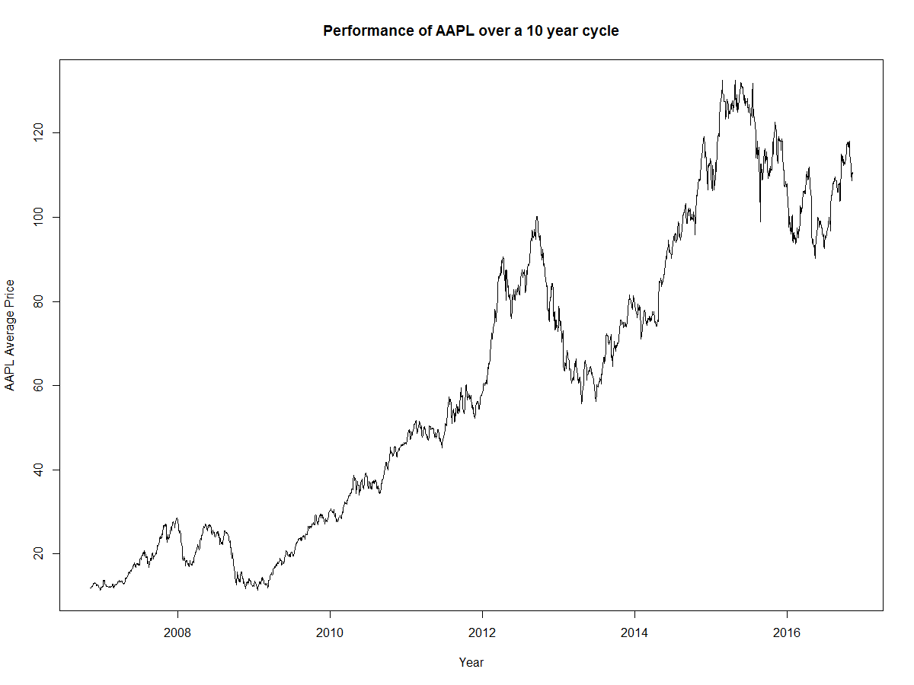

Slide 4
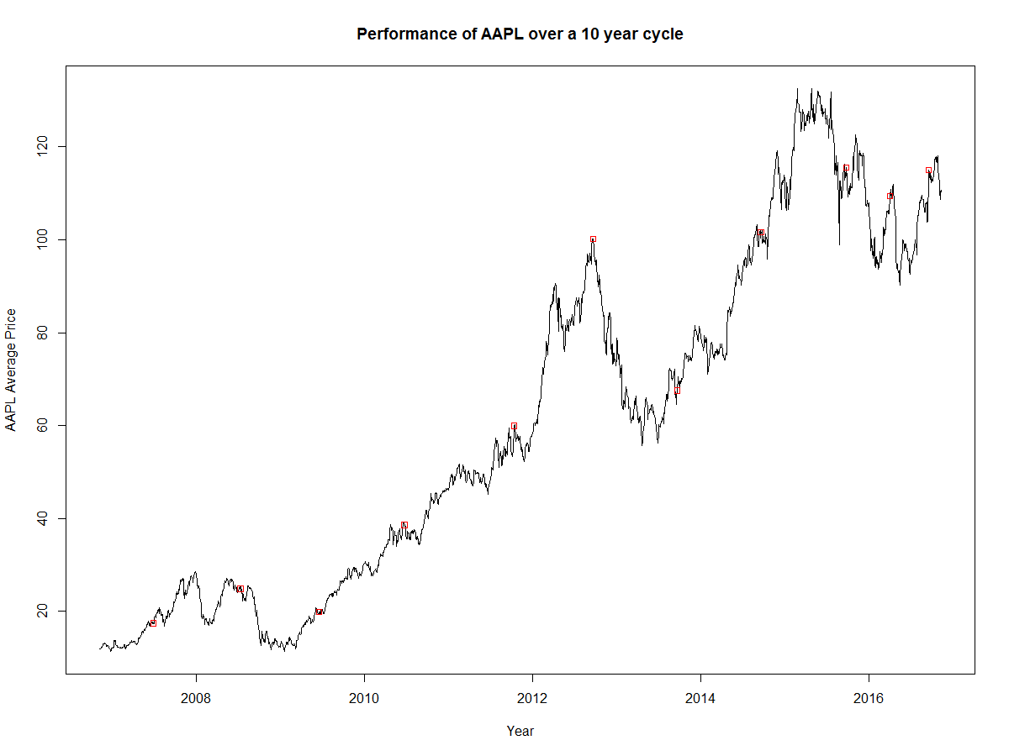

Slide 5
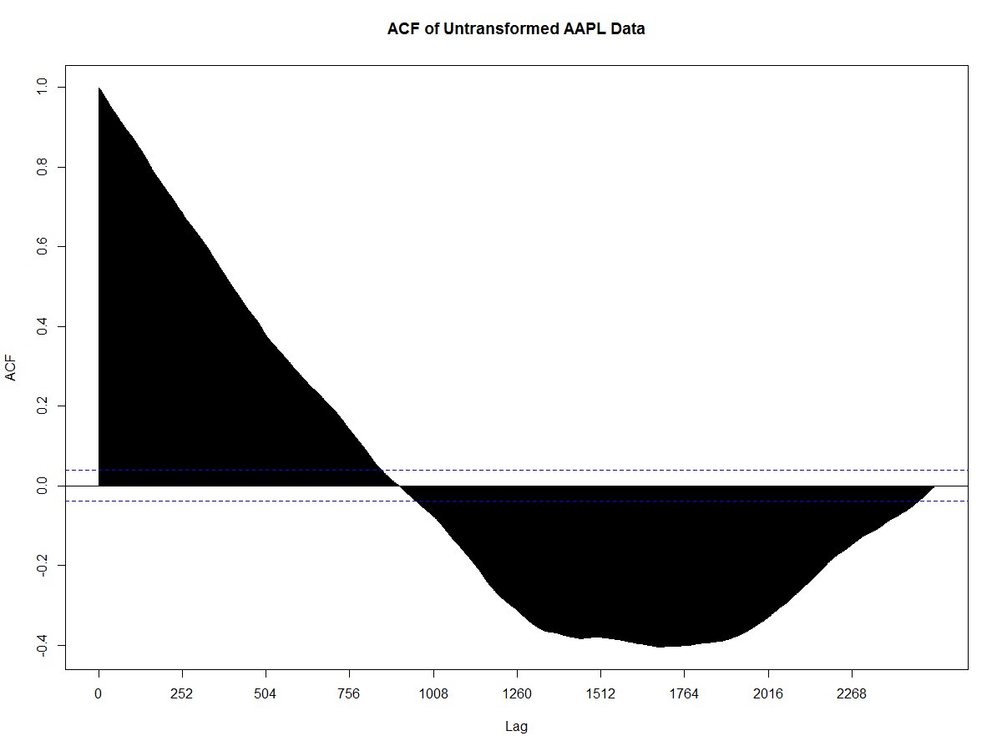

Slide 6
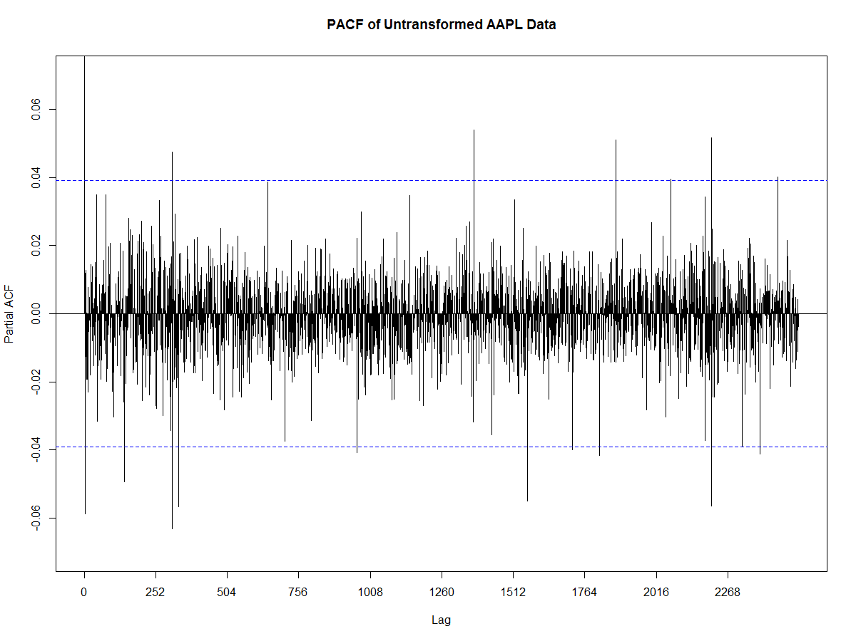

Slide 7
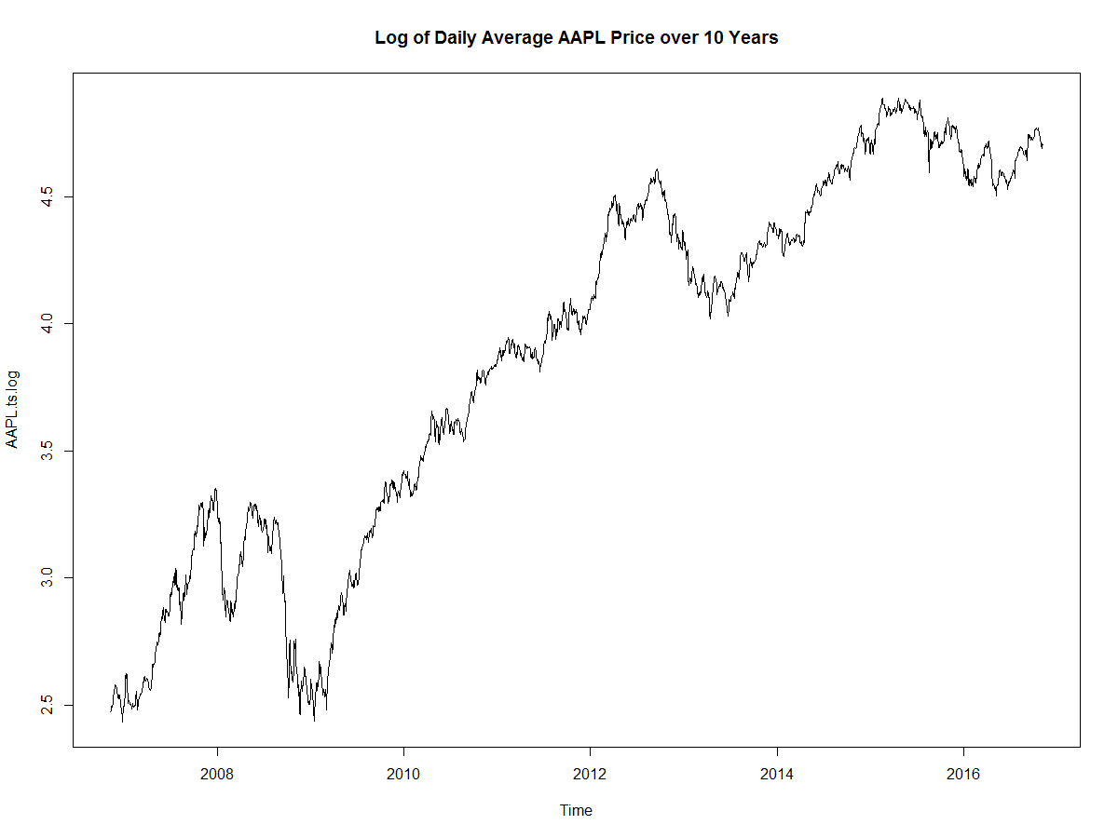

Slide 8


Slide 9
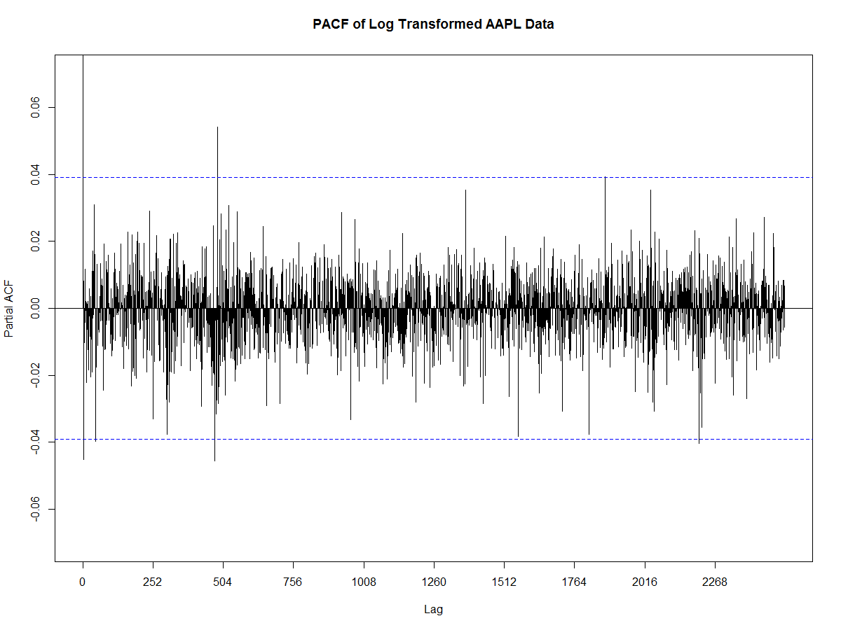

Slide 10
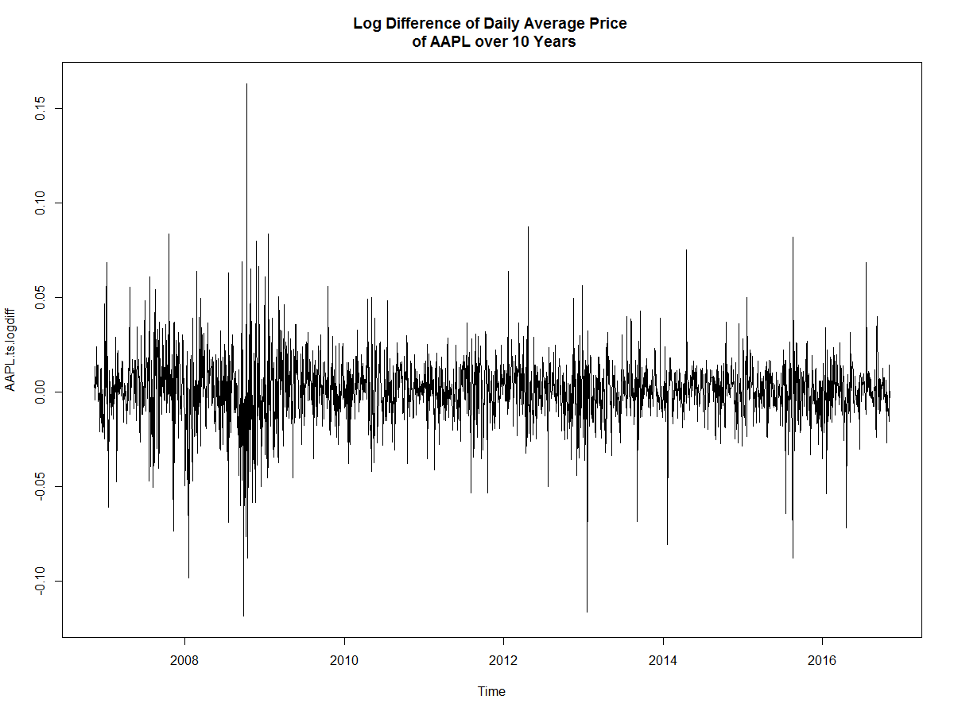

Slide 11
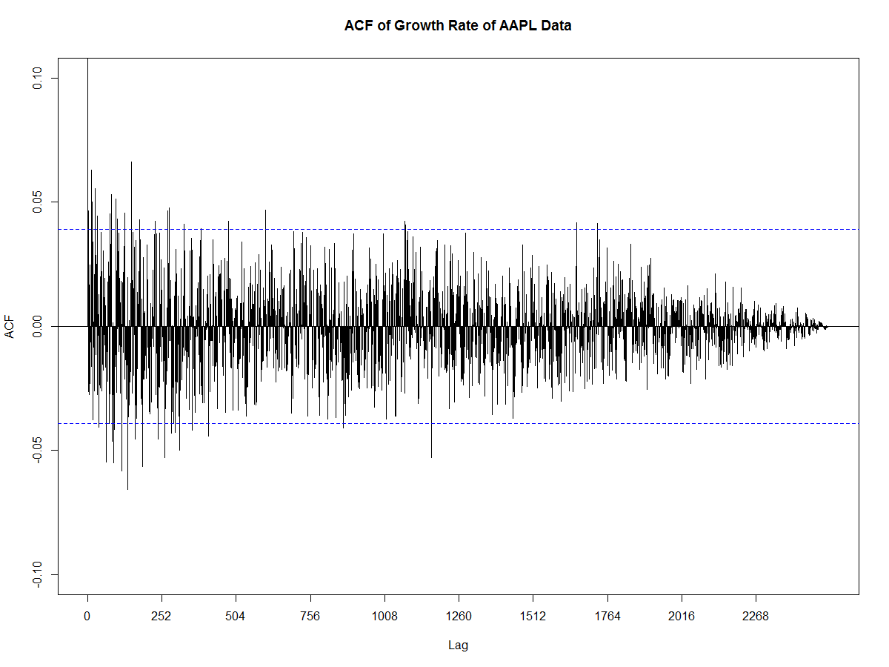

Slide 12
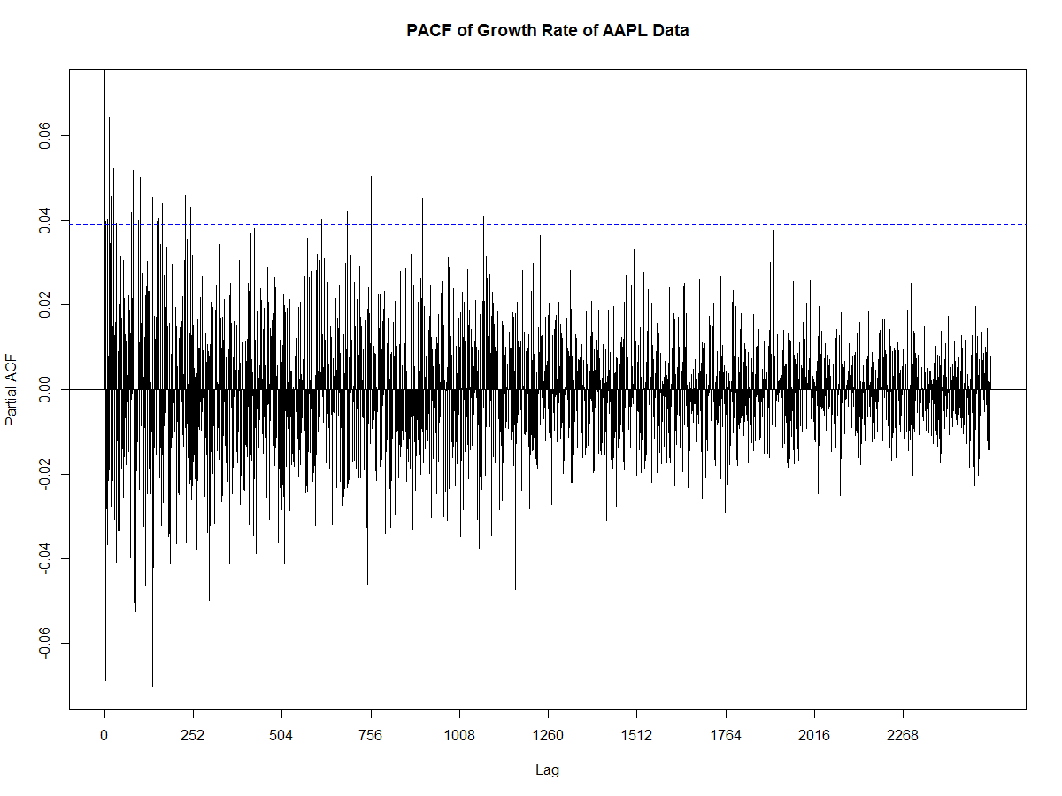

Slide 13
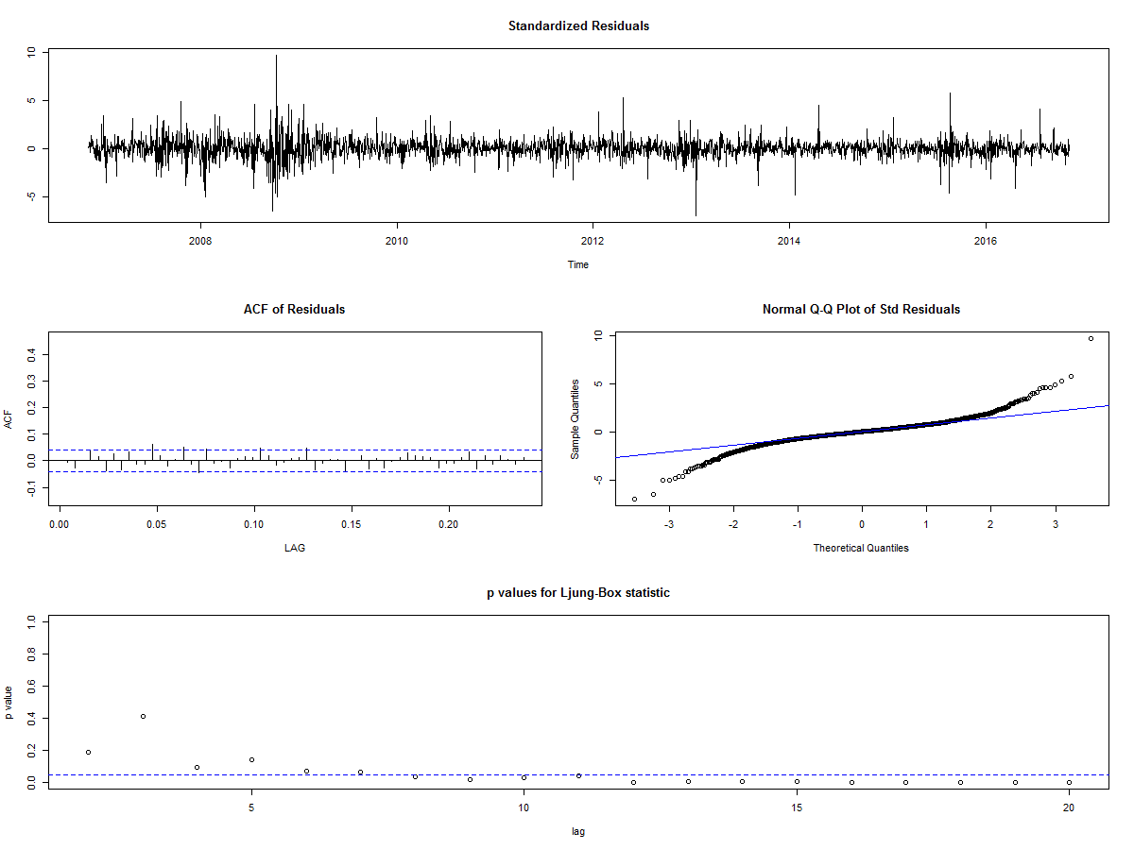
Summary Report for ARIMA(0,1,1)

Slide 14
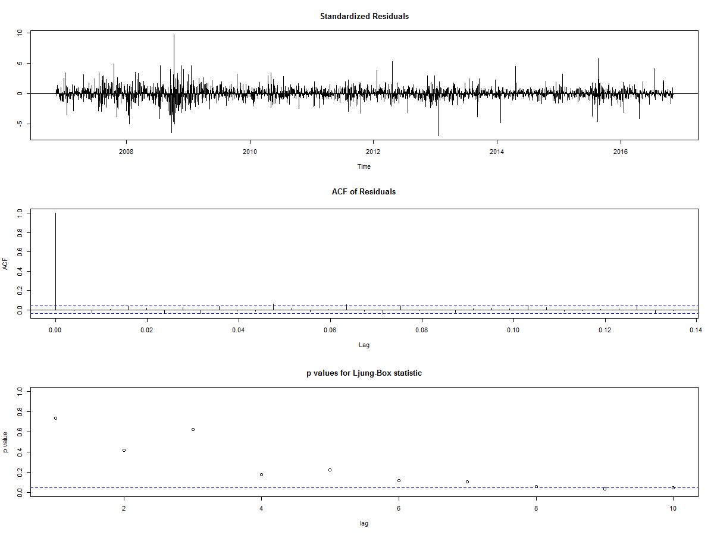

Slide 15
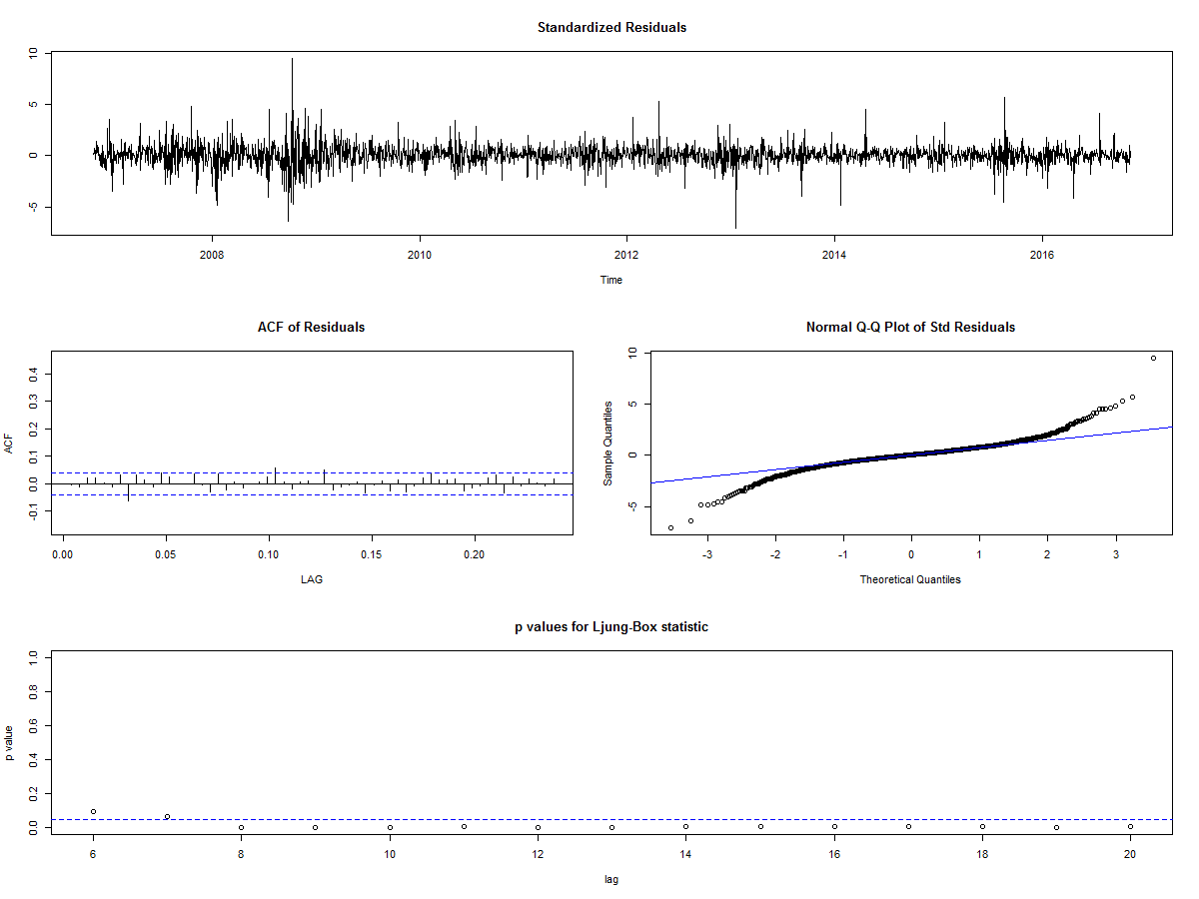
Summary Report of ARIMA(2,1,3)

Slide 16


Slide 17

Summary Report of ARIMA(5,1,5)

Slide 18
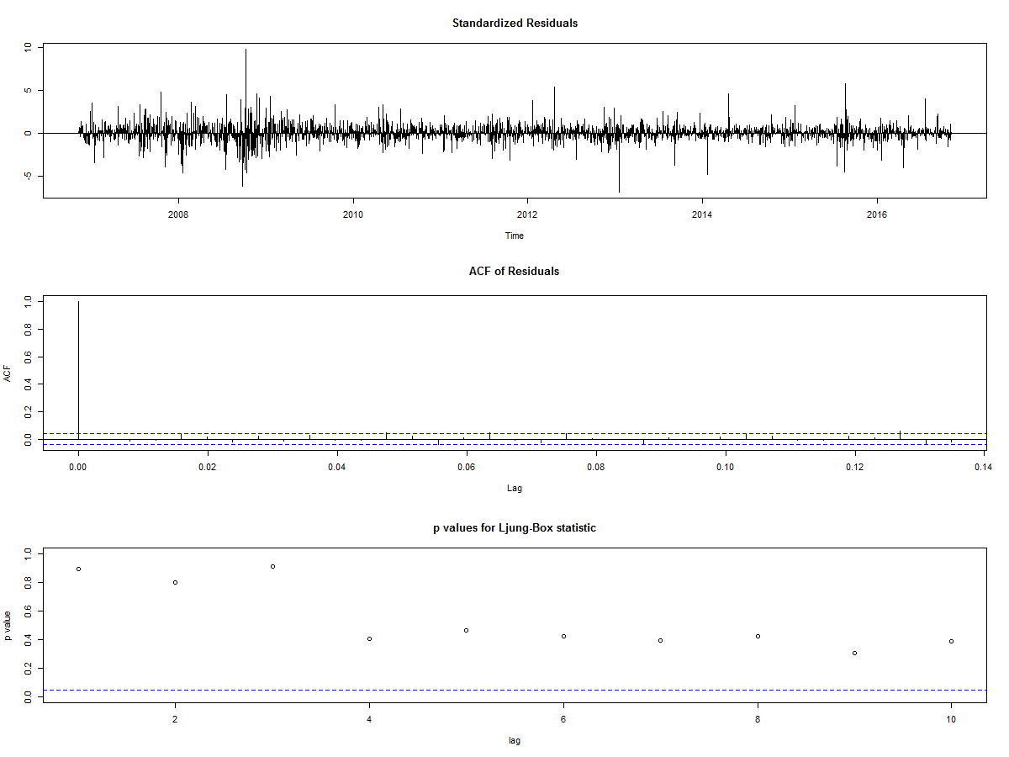

Slide 19

Summary Report of ARIMA(6,1,4)

Slide 20


Slide 21
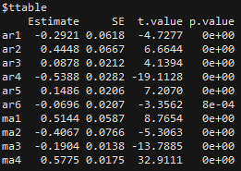
Final Model Arima(6,1,4)
Let $x_{t}$ = Difference of log average daily AAPL price. $$x_{t}={−0.2921}_{0.0618}x_{t−1}+{0.4448}_{0.0667}x_{t−2}+{0.0878}_{0.0212}x_{t−3}−{0.5388}_{0.0282}x_{t−4}+{0.1486}_{0.0206}x_{t−5} \\ −{0.0696}_{0.0207}x_{t−6}+w_{t}+{0.0.5144}_{0.0587}w_{t−1}−{0.4067}_{0.0766}w_{t−2}−{0.1904}_{0.0138}w_{t−3}+{0.5775}_{0.0175}w_{t−4}$$

Slide 22
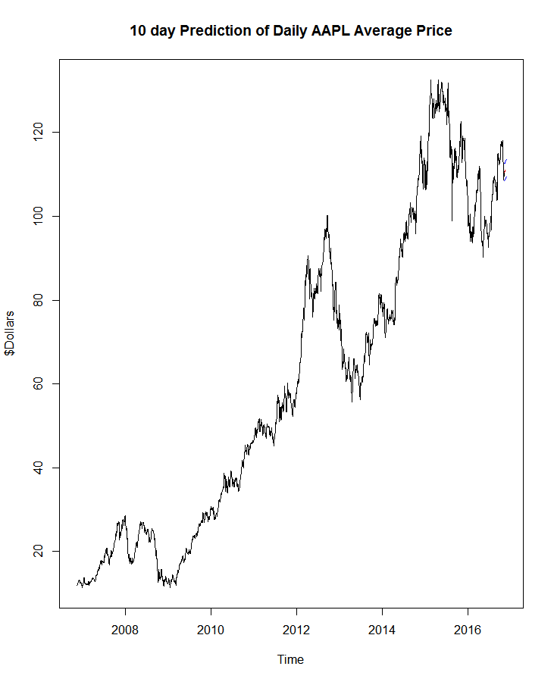

Slide 23
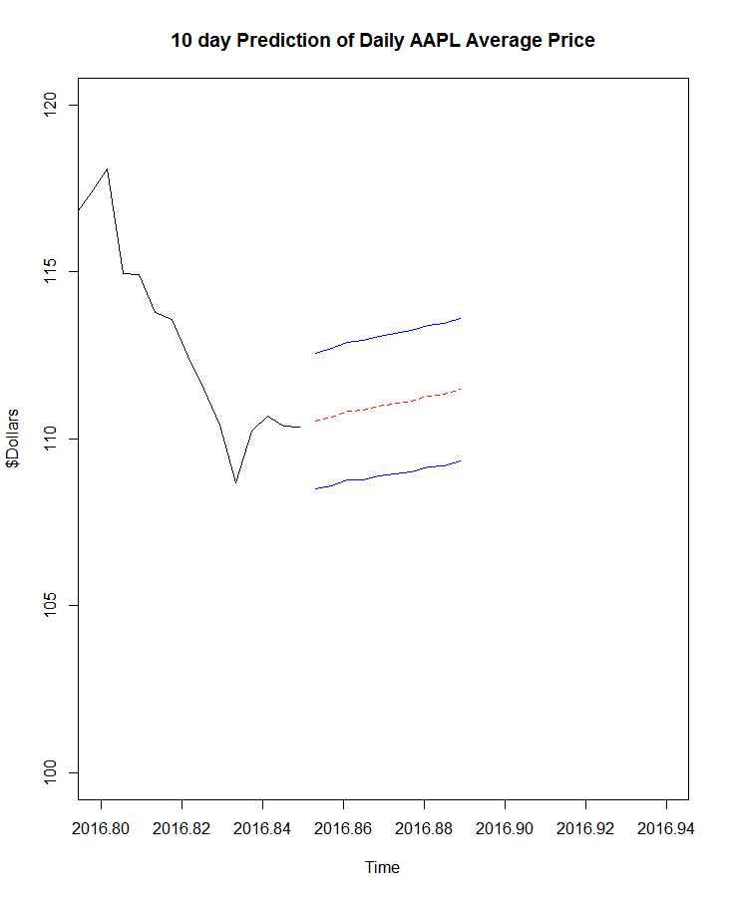

Slide 24
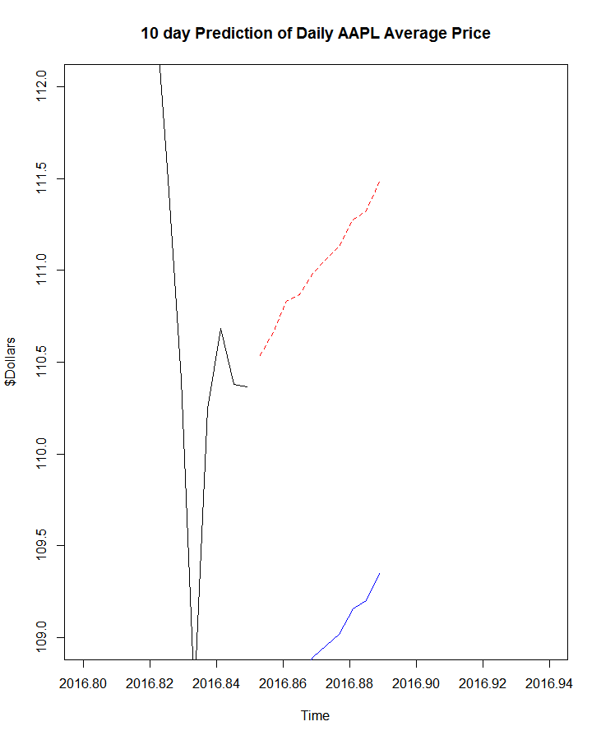

Slide 25
Forecast Results
Date | Predicted Value | Standard Error | Actual Value | % Error
2016-11-11 | 110.5361 | 1.02 | 107.775 | 2.56
2016-11-14 | 110.6624 | 1.03 | 106.710 | 3.70
2016-11-15 | 110.8316 | 1.03 | 106.840 | 3.74
2016-11-16 | 110.8675 | 1.04 | 108.345 | 2.34
2016-11-17 | 110.9838 | 1.05 | 109.880 | 1.00
2016-11-18 | 111.0573 | 1.05 | 109.890 | 1.06
2016-11-21 | 111.1289 | 1.06 | 110.925 | 0.18
2016-11-22 | 111.2733 | 1.06 | 111.875 | 0.53
2016-11-23 | 111.3259 | 1.06 | 111.295 | 0.03
2016-11-24 | 111.4815 | 1.07 | 111.460 | 0.02

Slide 26
Conclusion
GARCH Modelling
Applications of our model
ARIMA Sufficiency

Slide 27

Conclusion
GARCH Modelling
Applications of our model
ARIMA Sufficiency
This is the REAL world! Things don’t always work out!

Slide 28
Thanks

